Slide 1
DSA CS2002
Hashing

Slide 2
Hashing ref sec 8.2 Data Structrures in C++
10.5 in the textbook
Purpose:
Makes data retrieval much faster. Assume we have keys ranging from 1…N and a table of size M smaller than N. Now have a function h: {1..N} → {0.. M-1} and let h(x) be the location where a record with key x should be stored. This is the hash function.
In static hashing the keys are stored in a fixed-size table called the hash table, ht. The hash table is partitioned into b buckets, ht[0], …, ht[b-1]. Each bucket is capable of storing s records. Thus, a bucket is said to consist of s slots.. A hash function h(x) performs identifier transformation on x, it maps the set of possible identifiers (keys) onto the integers 0 through b-1.

Slide 3
Hashing
Identifier density= n/T where n is the number of identifiers in the table and T is the total number of possible identifiers.
Loading factor = α = n/(sM)
Overflow : occurs when a new identifier is hashed by h into a full bucket.
Collision: occurs when two nonidentical identifiers are hashed into the same bucket.When bucket size s is 1, collision and overflow occur simultaneously.

Slide 4
Example
Consider hash table ht with b =26 buckets and s=2. Assume that there are n=10 unique identifiers and that each identifier begins with a letter. The loading factor for this table is 10/52 =0.19. The hash function h must map each of the possible identifiers into one of the numbers 0 to 25. If the internal binary representation for the letters A to Z corresponds to the numbers 0 to 25, and the hash function:
h(x) = first character of x
The identifiers GA, D , A, G, L, A2, A1, A3, A4 and E will be hashed into buckets 6, 3, 0, 6, 11, 0, 0,0,0, 4 respectively by this function

Slide 5
For address 0 an overflow occurs when
identifier A1 gets hashed into bucket ht[0]
When no overflows occur, the time required to enter or search for identifiers using hashing depends only on the time required to compute the hash function h and time to search one bucket. Since bucket size, s, is usually small the search for an identifier within a bucket is carried out using sequential search. This time is independent of n.

Slide 6
Hash function
Desired properties of hash function
  It be easy to compute
  It should minimize the number of collisions
  It should depend on all characters in the identifier
  For random inputs, it should not result in biased use of hash table, i.e., for identifier x the probability that h(x)= i should be 1/b for all buckets i. Such a hash function is called a uniform hash function.

Slide 7
Hash Function
A simple type of hash function is the modulo
operator (%). The hash function is
h(x) = x%M
This function gives bucket addresses in the
range 0 to (M-1). The choice of M is critical.
If M is a power of 2, then h(x) depends only
on the least significant bits of x.
e.g. if we use 5 bits to represent character keys
A K E Y
00001 01011 00101 11001 = 1*32³ + 11*32² + 5*32 + 25 =44217
Now with M =2^{i} , i<= 5, all identifiers ending with the character
‘Y’ will have the same bucket address, i.e., the bucket address will
depend on one part of the key only. The use of hash table is thus
biased.

Slide 8
Hash Function
Similarly if M is divisible by two, the odd keys were
mapped to odd buckets and even keys are mapped to
even buckets.
These difficulties can be avoided by making M a
prime number, then only factors of M are M and 1.
In practice it has been observed that it is sufficient to
choose M such that it has no prime divisors less than
20.

Slide 9
Overflow Handling
Two ways to handle overflows :
Open addressing
Chaining

Slide 10
Overflow Handling :Open Addressing
In open addressing , we assume the hash table is an array and
that s =1. The hash table, ht, is initialized so that each slot contains
null identifier. When a new identifier is hashed into a full bucket,
we need to find another bucket for this identifier. The simplest
solution is to find the closest unfilled bucket.
This is called linear probing or linear open addressing.

Slide 11
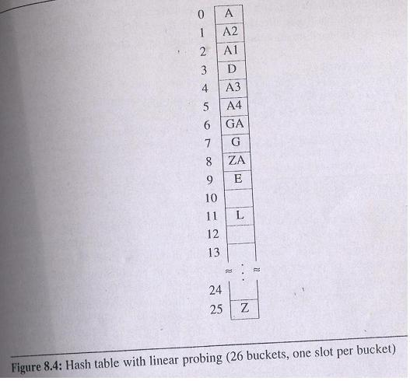

Example 8.3 : Assume we have M=26 and s=1 and the following identifiers: GA, D, A, G, L, A2, A1, A3, A4, Z, ZA, E
h(x) = first character of x

Slide 12
Overflow Handling :Open Addressing
When linear open addressing is used to handle overflows, a
hash table search for identifier x proceeds as follows:
Compute h(x)
Examine identifiers at positions ht[h(x)], ht[h(x) +1], …., ht[h(x) +j], in this order until one of the following happens:
(a) ht[h(x) +j] = x, in this case x is found
(b) ht[h(x) +j] is null, x not in the table.
(c) We return to starting position ht[h(x)]; the table is
full and x is not in the table.

Slide 13
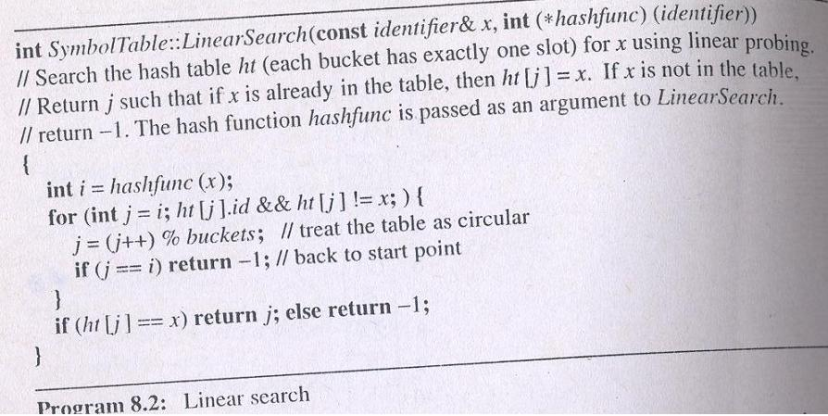

Slide 14
Overflow Handling :Open Addressing - Analysis
For example 8.3:
Number of buckets examined is 1 for A, 2 for A2, 3 for A1, 1 for D, 5 for A3,…., 10 for ZA – a total of 39 buckets examined for 12 identifiers, average of 3.25 buckets per identifier
Expected average number of identifier probes , P, to look for an identifier = (2-α)/(2-2α) , where α is the loading density
For above example α = 12/26 =0.47 and P=1.5

Slide 15
Overflow Handling :Open Addressing - Analysis
Problem with linear open addressing is it tends to create clusters of identifiers. Moreover these clusters tend to merge as more identifiers are entered, leading to bigger clusters.
Worst-case performance is really bad.
Example of average behaviour:
M= 11113, n=10000, α=0.9
Hashing using linear probing: 5.5
Binary search: 12.29
Linear search: 5000
Some improvement in the growth of clusters and hence in the average number of probes needed for search can be obtained by quadratic probing or by using rehashing techniques

Slide 16
Homework
Q1. Using the simple linear probing method show how the
following sequence of numbers will be inserted into a
hash table using the modulo function as our hash
function and table size of 13:
13 17 21 12 9 8 6 26 0 4 34 47

Slide 17
Overflow Handling : Chaining
In linear probing the search for an identifier
involves comparison with identifiers that have
different hash values.
Using separate chaining we reduce the
number the comparisons carried out by
maintaining list of identifiers:
One list is kept per bucket, each list containing all the synonyms for that bucket.
A search involves computing the hash function h(x) and examining only those identifiers in the list for h(x).
As the size for these lists is not known in advance, the best way to maintain them is as linked chains.

Slide 18
Overflow Handling : Chaining
Each chain has a head node
The size of head node is small as it only retains a link
Since the lists are to be accessed at random, the head nodes should be sequential. We assume they are numbered 0 to b-1 if the hash function h has range 0 to b-1.

Slide 19
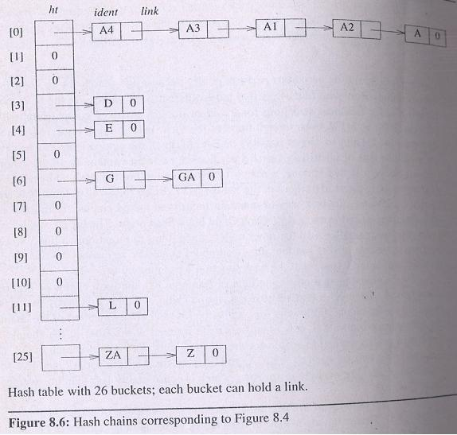
Overflow Handling : Chaining
Using Chaining for example 8.3 which had M=26 and s=1 and the following
identifiers: GA, D, A, G,
L, A2, A1, A3, A4, Z, ZA, E
h(x) = first character of x
In this example new identifiers
are inserted at the front of the
chains. The number of probes
needed for A4, D, E, G, L
and ZA is 1; for A3, GA and
Z is 2; for A1 3, for A2 4;
for A 5. A Total of 24 which
gives an average of 2 which is
less than the average for
linear probing

Slide 20
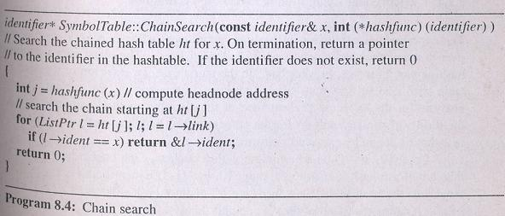
Overflow Handling : Chaining - Search

Slide 21
Overflow Handling : Chaining - Analysis
The expected number of identifier comparisons = (1+ α/2), where α is the loading density n/b
Deletion is possible and easy
As long as a uniform hash function is used, the performance of a hash table depends only on the method used to handle overflows

Slide 22
Homework
Q1. Given M=11 and the following sequence of numbers,
show the final hash table using separate chaining and
the simple modulo function as our hash function:
112 41 34 2 98 16 35 74 77 0 32

